Slide 1

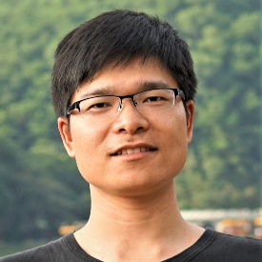
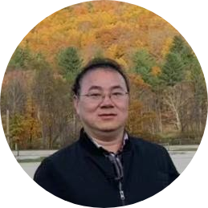
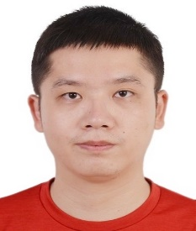




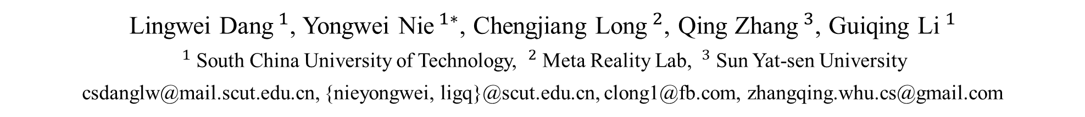
Diverse Human Motion Prediction via Gumbel-Softmax Sampling from an Auxiliary Space
Lingwei Dang$^{1}$, Yongwei Nie$^{1∗}$, Chengjiang Long$^{2}$, Qing Zhang$^{3}$, Guiqing Li$^{1}$
$^{1}$South China University of Technology, $^{2}$Meta Reality Lab, $^{3}$Sun Yat-sen University
csdanglw@mail.scut.edu.cn, {nieyongwei, ligq}@scut.edu.cn, clong1@fb.com, zhangqing.whu.cs@gmail.com
Notes:
Hello everyone. In this paper, we introduced a novel framework titled DOA-GAN for detecting and localizing copy-move manipulation in images.

Slide 2
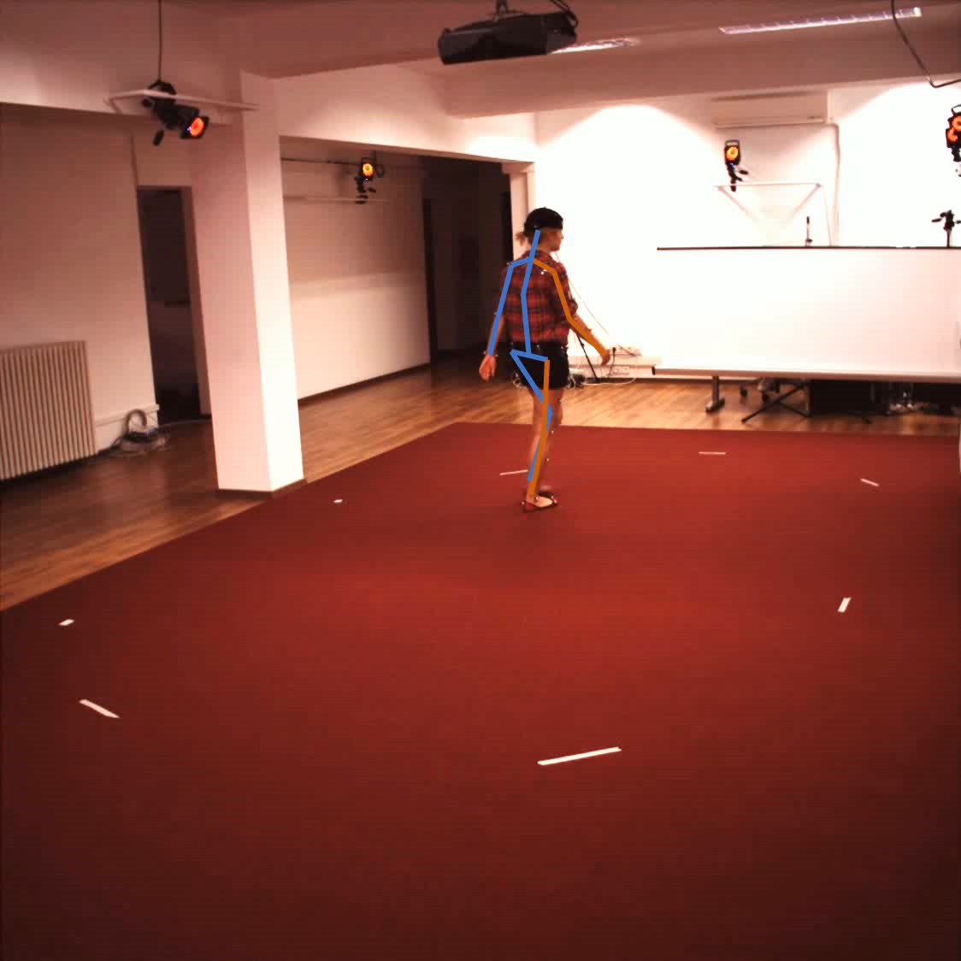
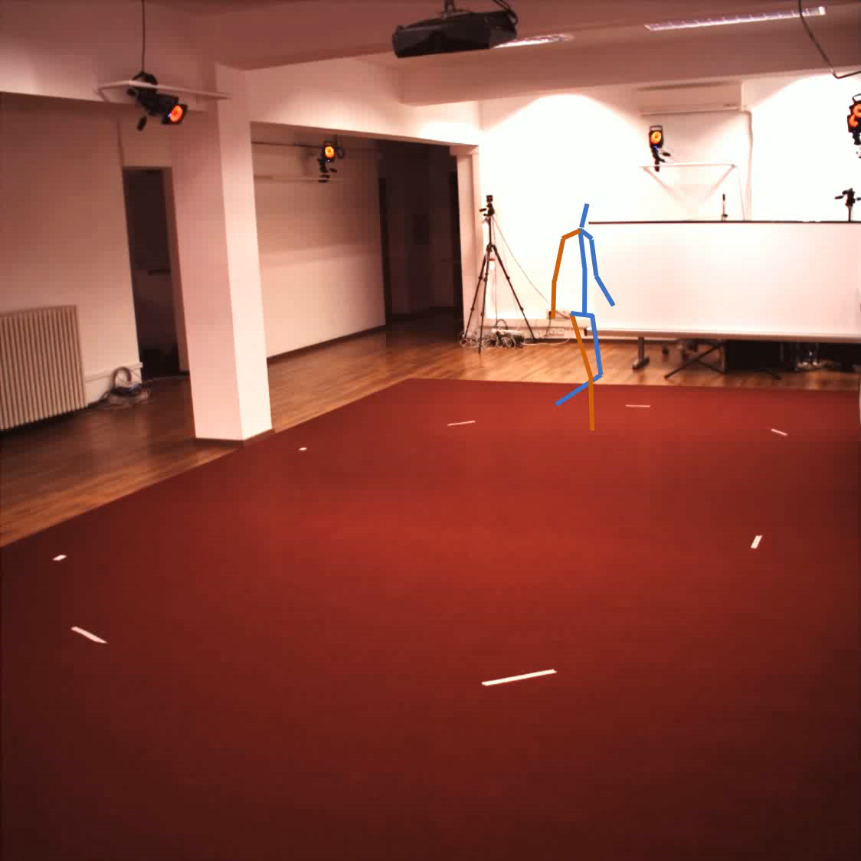
Human Motion Prediction (HMP)
Observed Seq
Future Seq
Notes:
The task of Human Motion Prediction (HMP) is that given the sequence of past human poses
We want a model to predict human motions in the future.

Slide 3
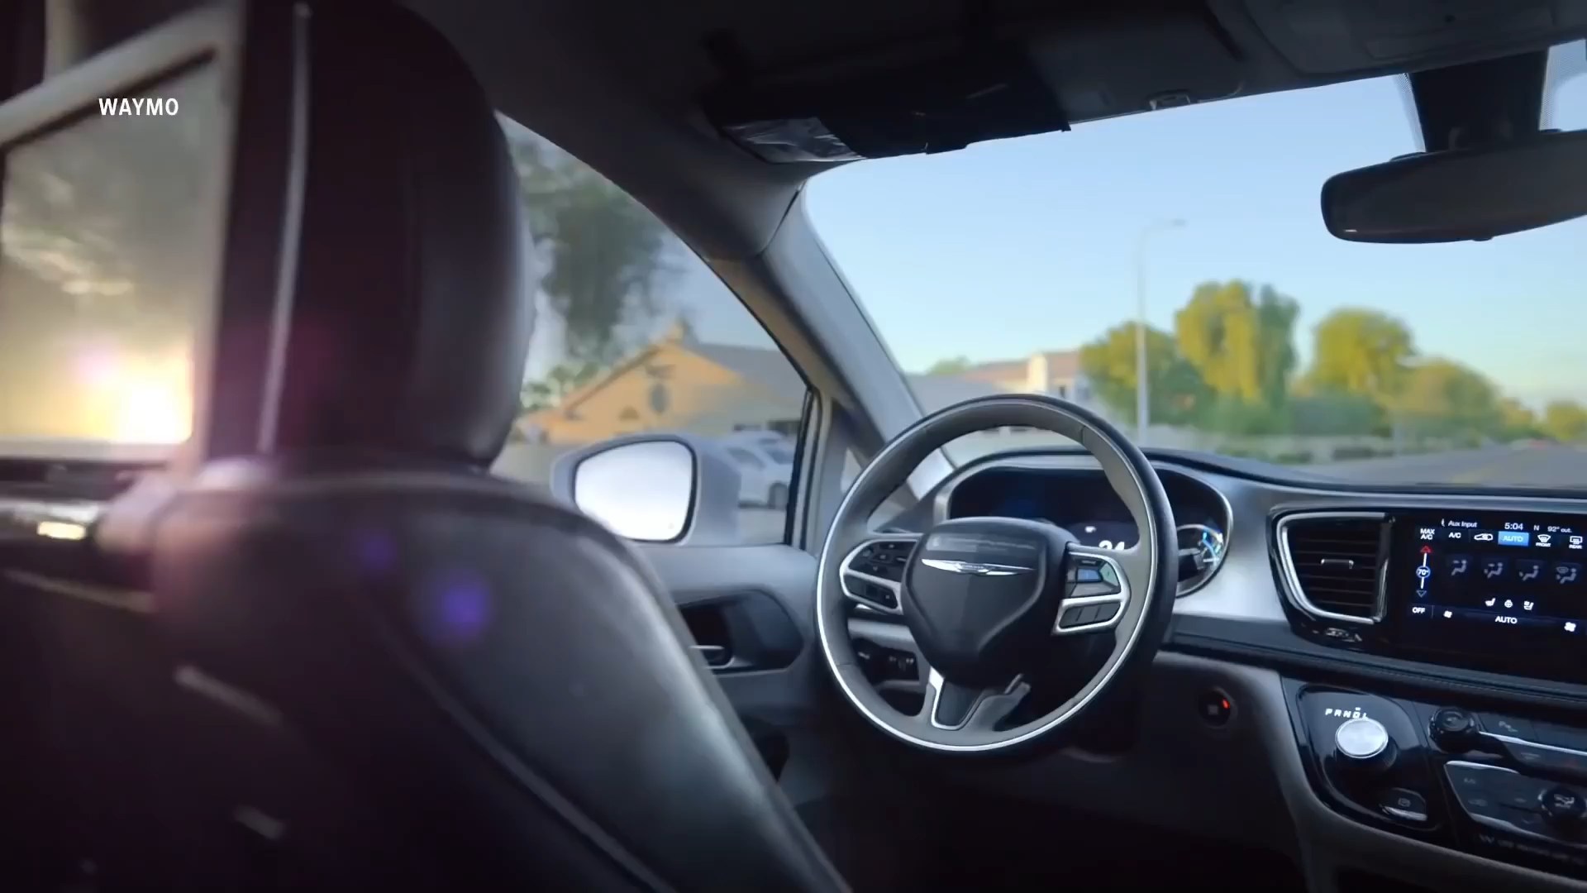
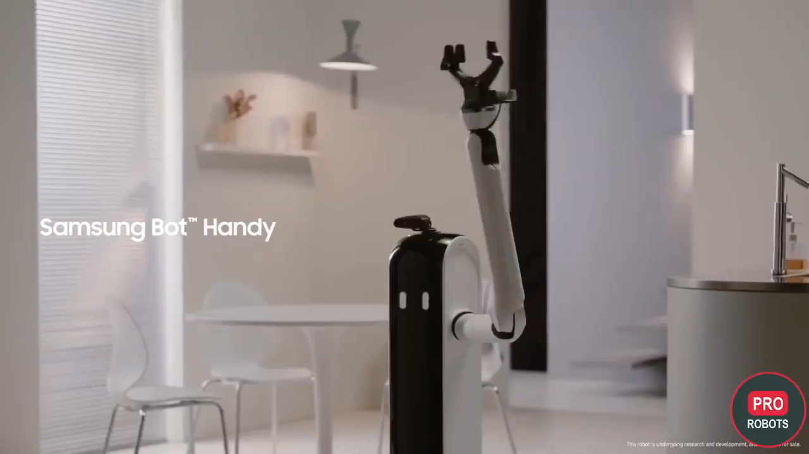
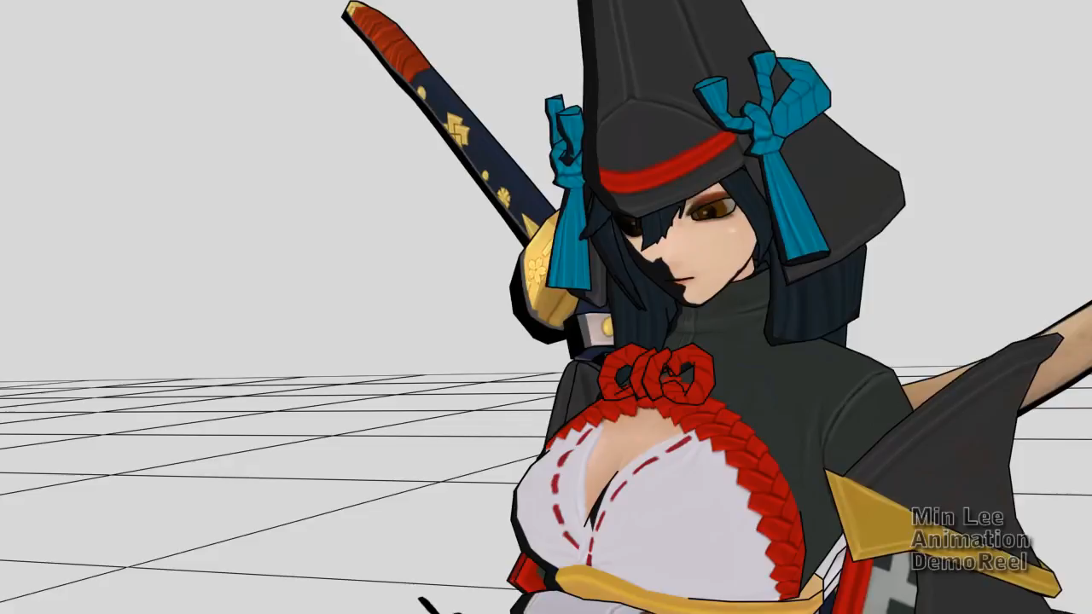
Applications
autonomous driving
human-computer interaction
animation creation
Notes:
It has a wide range of applications in autonomous driving, human-robot interaction, and animation creation.

Slide 4
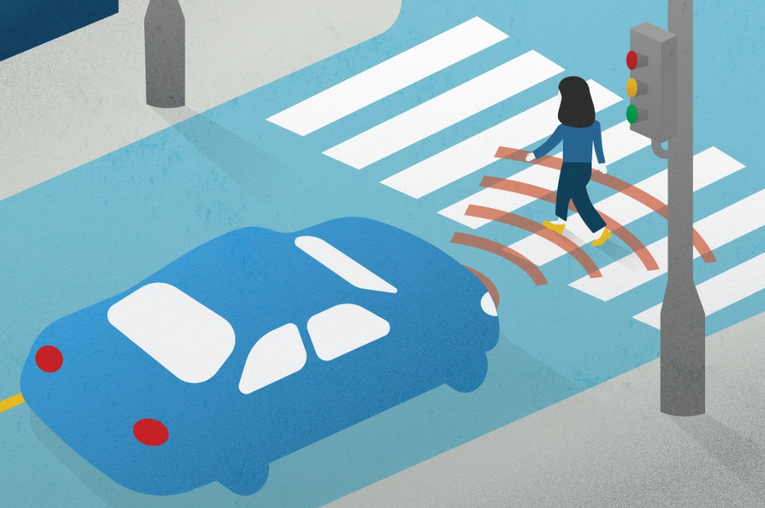
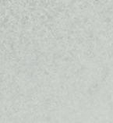
Deterministic HMP
Predict only one motion in the future
Ignore the uncertainty of human motion
Cannot satisfy some safety-critical applications
LTD Mao W, et al., ICCV 2019
HisReps Mao W, et al., ECCV 2020
LDR Cui Q, et al., CVPR 2020
MSR Dang L, et al., ICCV 2021
MLMA Mao W, et al., IJCV 2021
PGBIG Ma T, et al., CVPR 2022
Notes:
There are two types of approaches for HMP.
Most previous works perform deterministic HMP that predict only one motion in the future.
However, due to the stochasticity of human motion, multiple solutions naturally exist, and forecasting them is of great importance in practice, such as autonomous driving.
For example, it would be better for a vehicle to know that a pedestrian in front of it may not only walk ahead but also turn left suddenly.

Slide 5
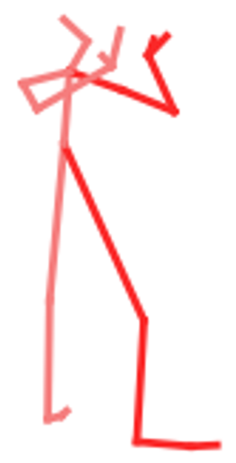
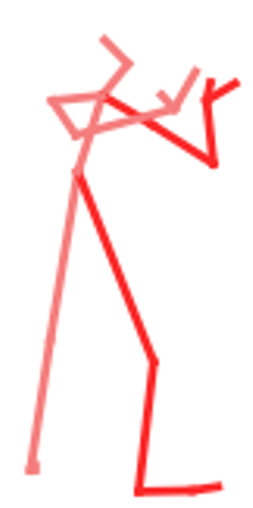

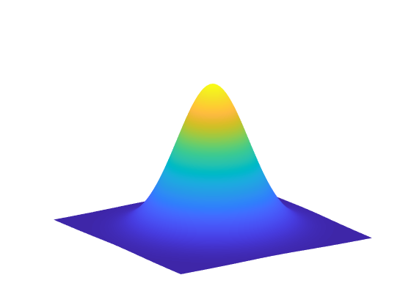
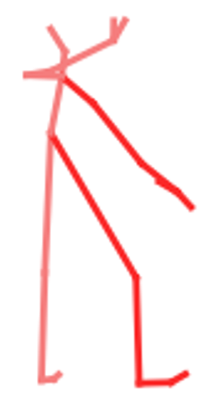
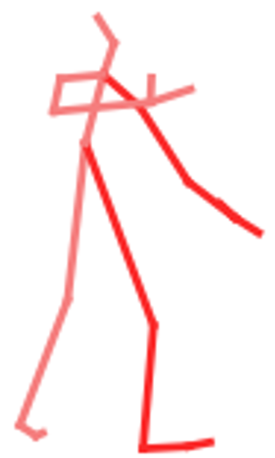

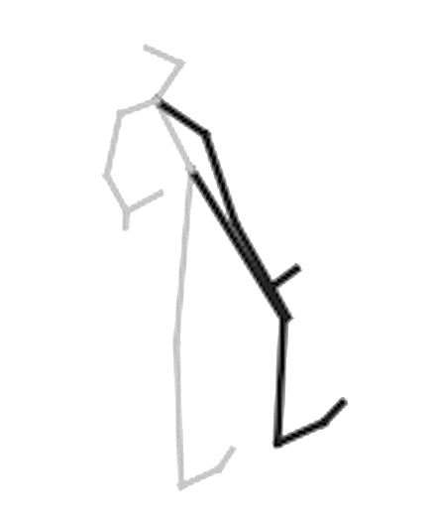
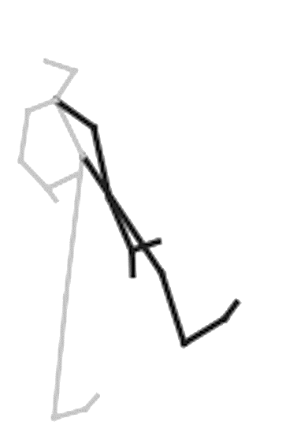
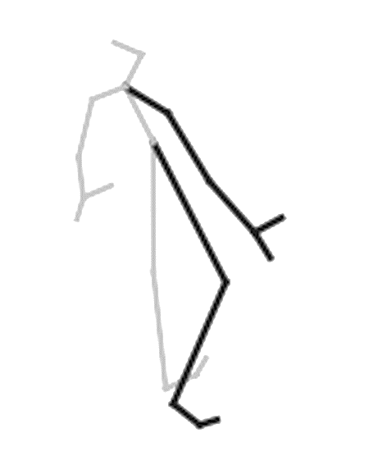
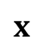
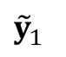
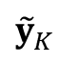
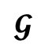
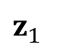
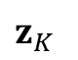
Stochastic and Diverse HMP
Adopt deep generative networks, e.g. GAN or CVAE to model the conditional distribution of future poses given previous ones
Sample random noises and decode them into multiple possible future motions
$$z_{1}$$
$$𝓖$$
$${\tilde{y}}_{1}$$
…
…
$${\tilde{y}}_{K}$$
$$z_{K}$$
$$x$$
Hp-gan Barsoum E, et al., CVPR 2018
Bihmp-gan Kundu J, et al., AAAI 2019
MNM Li B, et al., TIP 2020
Notes:
Recently, many diverse and stochastic HMP approaches adopt deep generative networks, such as GAN or CVAE to model the conditional distribution of future poses given previous ones.
They randomly sample latent variables from Gaussian distribution and decode into multiple possible future motions.

Slide 6

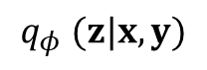
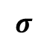
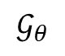
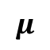
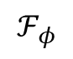
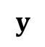
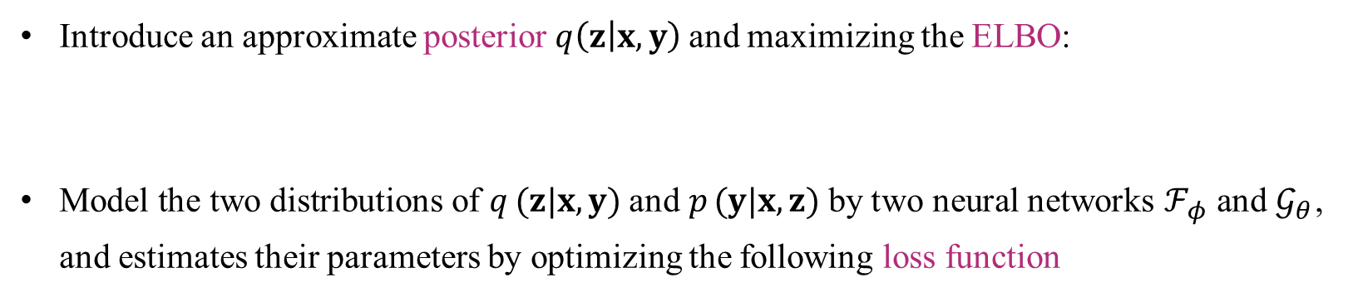


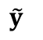
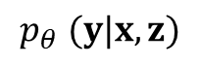
Example: CVAE-based Approach
$$q_{φ} (z|x, y)$$
$$p_{θ} (y|x, z)$$
$$x$$
$$𝒢_{θ}$$
$$x$$
$$μ$$
$$ℱ_{φ}$$
Reparameterize
$${\tilde{y}}_{ }$$
Generator
$$z$$
Encoder
$$y$$
$$σ$$
Introduce an approximate posterior$q\left(z | x, y\right)$ and maximizing the ELBO:
Model the two distributions of $q_{ }(z|x, y)$and $p_{ }(y|x, z)$by two neural networks $ℱ_{φ}$and $𝒢_{θ}$, and estimates their parameters by optimizing the following loss function
AEVB Kingma D, et al., arXiv 2013

Slide 7
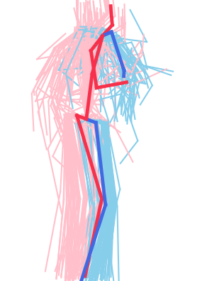
Limitations
learns an imbalanced multimodal conditional distribution
Latent codes correspond to the dominant modes, while ignoring other minor modes
CVAE
Decoding
CVAE
Sampling
Latent Codes
Gaussian
Distribution
Covered Modes
Predicted Last Poses
Notes:
Taking CVAE as an example, after training a CVAE, one can randomly sample latent codes from a prior Gaussian distribution, and then decode the random noises to future sequences by the CVAE decoder.
However, since the CVAE model is obtained by maximizing the likelihood of the training data which is often highly imbalanced, it usually learns an imbalanced multimodal conditional distribution. Latent codes drawn at random from the prior distribution most probably correspond to the most likely results that fall in the dominant mode of the distribution of data, while ignoring other results of low probability but high fidelity.

Slide 8
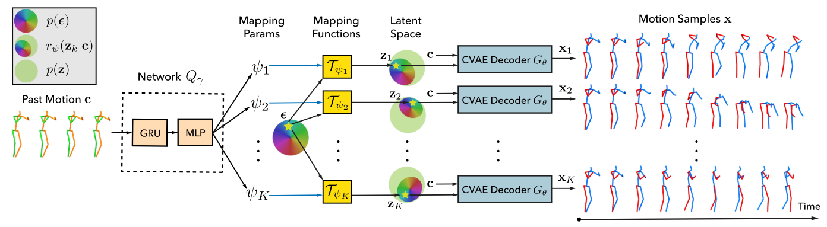
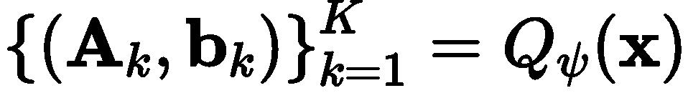
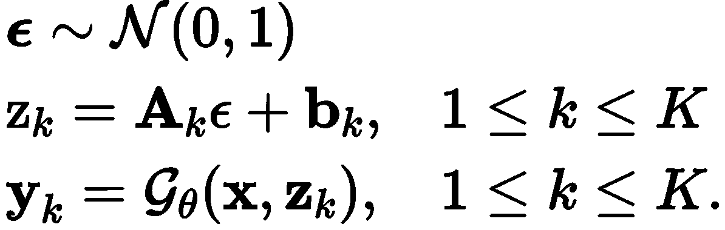
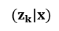
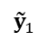
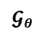
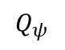
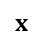
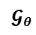
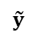
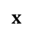
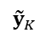
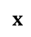
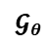
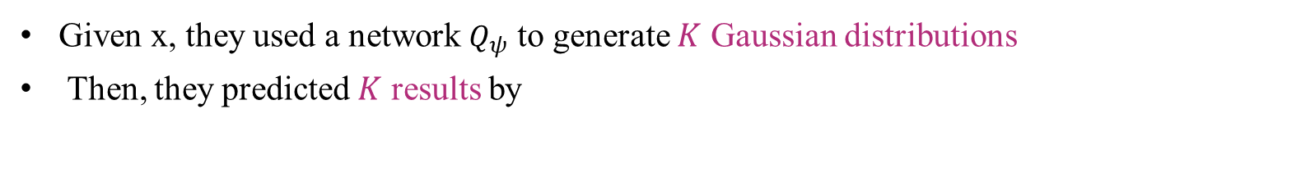


Stochastic and Diverse HMP: DLow
$${\tilde{y}}_{ }$$
$$(z_{k}|x)$$
$$x$$
$${\tilde{y}}_{1}$$
$$𝓖_{θ}$$
$$Q_{ψ}$$
$$x$$
$${\tilde{y}}_{2}$$
$$x$$
$$𝓖_{θ}$$
$$x$$
$${\tilde{y}}_{K}$$
$$𝓖_{θ}$$
Given x, they used a network $Q_{ψ}$ to generate $K$ Gaussian distributions
Then, they predicted $K$ results by
DLow Ye Y, et al., ECCV 2020

Slide 9




Limitations
Can only generate a fixed number of Gaussian distributions
Entangles the performance of diverse prediction with the learning of the network parameters, requiring to consider all training data and make tradeoffs
Generating
Sampling &
CVAE Decoding
DLow
Observed Poses
Gaussian Distributions
Covered Modes
Predicted Last Poses
Notes:
Recently, Yuan et al. proposed a method called DLow sampling, given observed poses, DLow uses a neural network to generate multiple Gaussian distributions, and then samples latent codes from all the generated Gaussian distributions.
However, directly generating Gaussian distributions has two limitations.
Firstly, a network can only generate a fixed number of Gaussian distributions, while there may exist much more modes in the target data distribution.
Secondly, it entangles the performance of diverse prediction with the learning of the network parameters, requiring the latter to consider all training data and make tradeoffs between them, thus in turn limiting the diverse prediction performance.

Slide 10

Our Method: Key Insights
Learn an auxiliary space then sample points from the it and map them to Gaussian distributions which finally correspond to different modes of the target distribution
Disentangles the correlation between diverse prediction and the network parameter learning
Arbitrary number of samples can be generated after the auxiliary space is built
Basis Vector
Gumbel-Softmax
Sampling
Sampling &
CVAE Decoding
Ours
Generating
Gaussian Distributions
Observed Poses
Auxiliary Space
Covered Modes
Predicted Last Poses
Notes:
we propose a sampling strategy that disentangles the above direct dependency between a network and the intermediate Gaussian distributions.
we learn a set of basis vectors from the observed poses. We assume that the basis vectors determine an auxiliary space, and any linear combination of the basis vectors corresponds to a point in the auxiliary space.
We randomly sample a set of points from the auxiliary space by the Gumbel-Softmax sampling strategy, and then map them to Gaussian distributions which finally correspond to different modes of the target distribution.
In other words, we use a network to learn an auxiliary space, and build the following connection between the auxiliary space and the target distribution: randomly sampling from the auxiliary space corresponds to diverse sampling from the target distribution. The diverse prediction is now tied to the structure of the auxiliary space rather than directly to the parameters of a network.

Slide 11


















Our Method
Basis Vector
Gumbel-Softmax Sampling
Observed
Poses $x$
$$𝓝_{β}$$
Sampling
$$z_{1}$$
CVAE
Decoding
$${\tilde{y}}_{1}$$
$$A_{1}, b_{1}$$
Base Matrix $B$
Sampling
$$z_{2}$$
CVAE
Decoding
$${\tilde{y}}_{2}$$
$$A_{2}, b_{2}$$
Gumbel-Softmax Sampling
…
…
$$π=0.025$$
$$τ=1$$
~
$$W_{i}$$
Point Matrix
$$𝓝_{γ}$$
CVAE
Decoding
…
$$A_{K}, b_{K}$$
Sampling
$$z_{K}$$
$${\tilde{y}}_{K}$$
Gumbel
distribution
Sampling
Softmax
Coefficient Matrix $W$

Slide 12


Training Losses
Hinge-diversity loss
Accuracy loss
KL loss

Slide 13

Quantitative Results
All the results are calculated by sampling 50 times for each input historical pose sequence.
MSR Dang L, et al., ICCV 2021
GSPS Mao W, et al., ICCV 2021 (Oral)
DLow Ye Y, et al., ECCV 2020

Slide 14

Qualitative Results
GT
10 predicted results
Human3.6M dataset
DLow Ye Y, et al., ECCV 2020
GSPS Mao W, et al., ICCV 2021 (Oral)

Slide 15

Qualitative Results
GT
10 predicted results
HumanEva-I dataset
DLow Ye Y, et al., ECCV 2020
GSPS Mao W, et al., ICCV 2021 (Oral)

Slide 16

Qualitative Results
DLow Ye Y, et al., ECCV 2020
GSPS Mao W, et al., ICCV 2021 (Oral)

Slide 17

QR Code for our project:
https://github.com/Droliven/diverse_sampling
Thank you!
Acknowledgement
This work is sponsored by Prof. Yongwei Nie's and Prof. Guiqing Li's Natural Science Foundation of China projects (62072191, 61972160), and their Natural Science Foundation of Guangdong Province projects (2019A1515010860, 2021A1515012301).
Notes:
To know more details about our work, please refer to the paper. Thank you.

